Slide 1
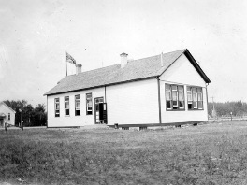
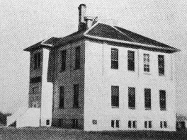
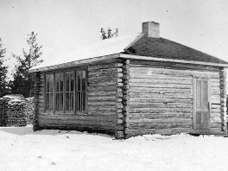
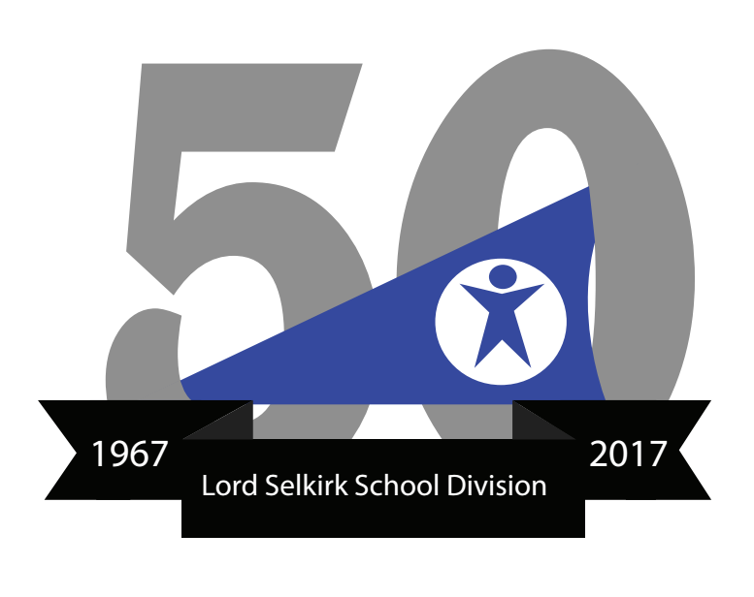
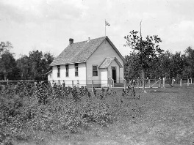
The school board set out to formulate a strategic plan to encompass current and future educational needs for all students. One of the first motions passed raised the salary for teachers who had completed university level training to $3,900 per year. New teachers were hired, financial allocations were set aside for new buildings and new programs were established.
Tenders were issued for the acquisition of transportation services – seven buses were needed, ranging from 30-passenger to 66-passenger buses, the remaining transportation needs to be met wit the use of seven vehicles.
Province-wide interest was growing in vocational education at the secondary school level, and 11 school districts in Manitoba, including LSSD, were selected for a pilot program offering a vocational studies option. By September, 1971 the new Lord Selkirk Regional Comprehensive Secondary School had opened, offering students supplementary study in the fields of industrial, occupational and business education
Accompanying the division’s expansion of educational responsibilities was an increase in staff levels and budget allocations.
The LSSD budget for the 1967-1968 year was $2.2 million.
The LSSD budget for the 2016-2017 year is $58.3 million.

